Slide 1
On the Convergence Issues of GANs
Speaker: Zhiming Zhou
Notes:
此页可以删除

Slide 2
About Me
Education:
  Ph.D. candidate in Computer Science, Shanghai Jiao Tong University.
  Bachelor’s degree obtained from ACM class, Shanghai Jiao Tong University.
Research Interest:
  Currently mainly focus on GANs. (2017 ~ now)
    Also work on related problems, including optimization, optimal transport, etc.
  Used to work on Computer Graphics. (2014 ~ 2016)
    Surface reflectance acquisition, related to sparsity, low-rank, and deblurring.
  Plan to extend and gradually move to Deep Learning Theory.

Slide 3
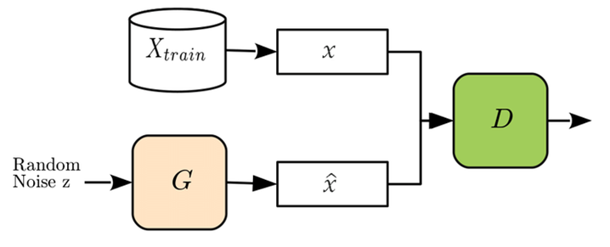
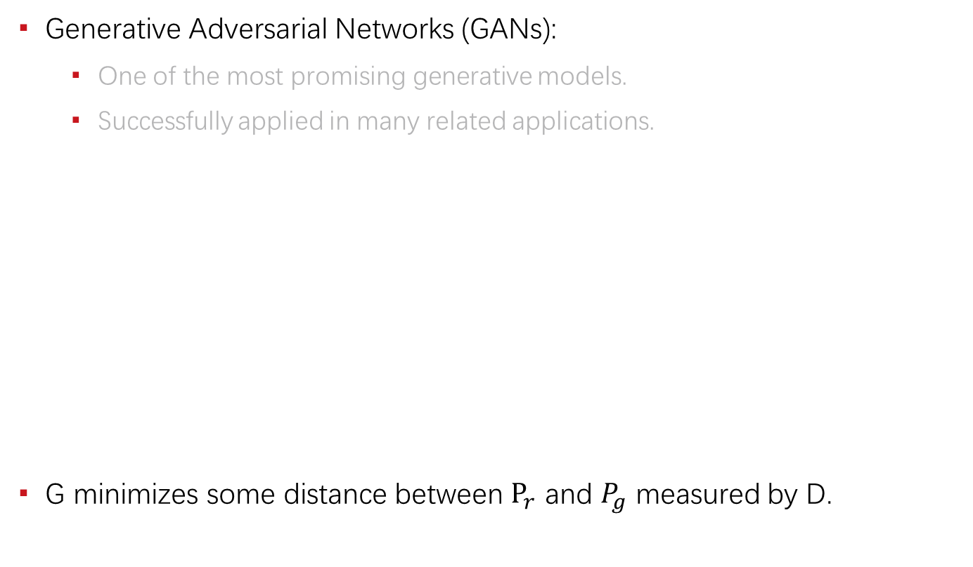
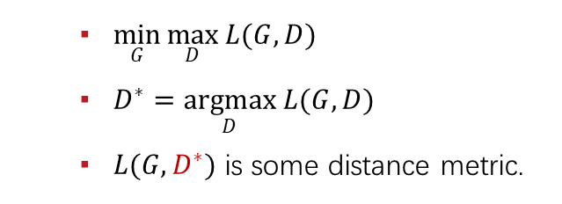
Introduction
Generative Adversarial Networks (GANs):
  One of the most promising generative models.
  Successfully applied in many related applications.
G minimizes some distance between $P_{r}$ and $P_{g}$ measured by D.
  $\min_{G}{\max_{D}{L(G, D)}}$
  $D^{∗}=\underset{D}{argmax}{L(G, D)}$
  $L(G, D^{∗})$ is some distance metric.

Slide 4




The Convergence Issues
Training instability
Unreachable optimum
Generalization issue
Symptoms:
  Hyperparameter sensitive
  Mode collapse
  Training failure (diverge / crash)
Related work:
  Lipschitz GANs. (ICML, 2019)
$$P_{g}^{(0)}$$
$$P_{g}^{(t)}$$
$$P_{r}$$
$$\tilde{P_{r}}$$
Training Instability
Unreachable optimum
Generalization Issue

Slide 5
Training Instability
Mainly from Lipschitz GANs. (ICML, 2019)

Slide 6
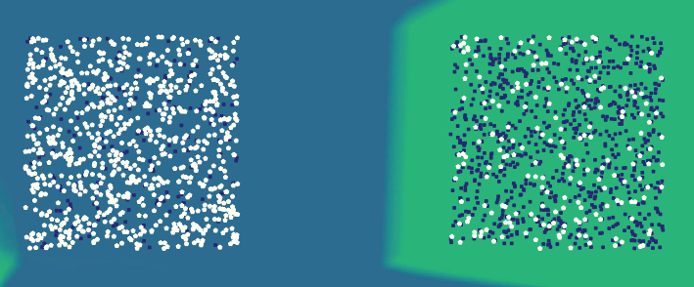
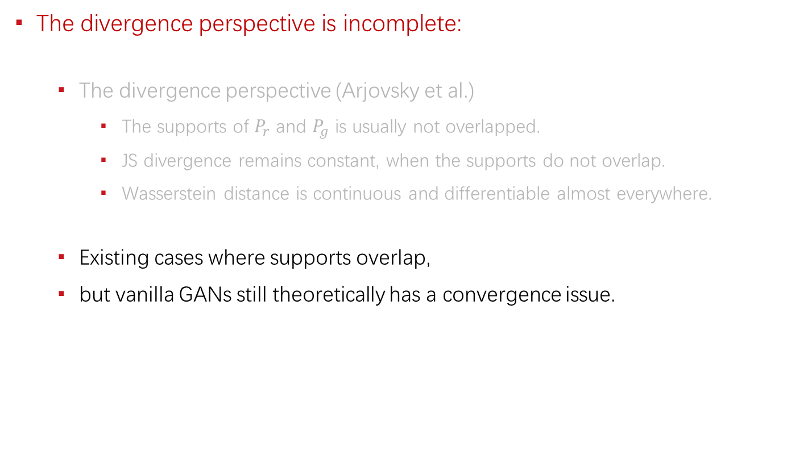
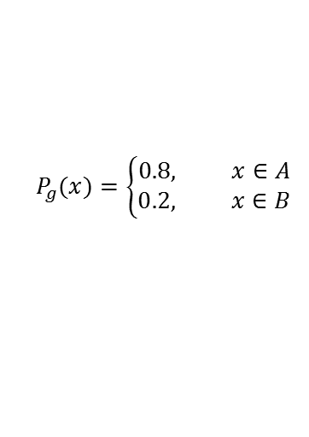
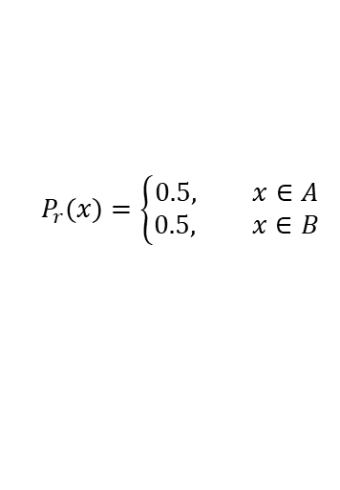
The Essence of Convergence
The divergence perspective is incomplete:
  The divergence perspective (Arjovsky et al.)
    The supports of $P_{r}$ and $P_{g}$ is usually not overlapped.
    JS divergence remains constant, when the supports do not overlap.
    Wasserstein distance is continuous and differentiable almost everywhere.
  Existing cases where supports overlap,
  but vanilla GANs still theoretically has a convergence issue.
$$P_{g}(x)=\left\{\begin{aligned}0.8, x∈A \\ 0.2, x∈B\end{aligned}\right.$$
$$P_{r}(x)=\left\{\begin{aligned}0.5, x∈A \\ 0.5, x∈B\end{aligned}\right.$$

Slide 7
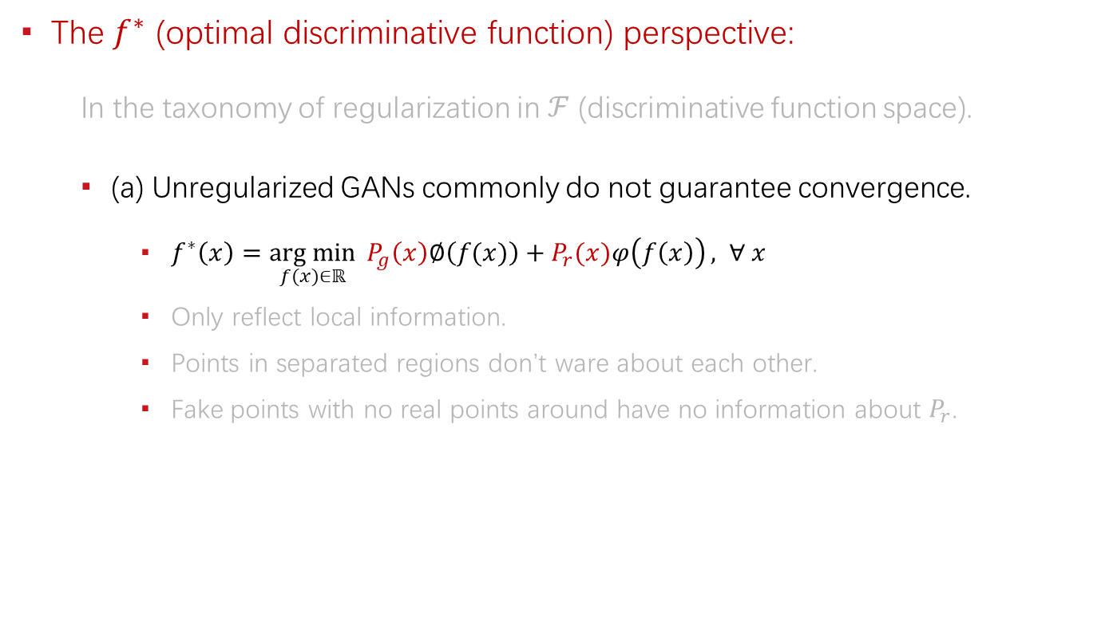
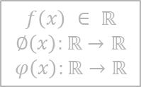
The Essence of Convergence
The $f^{∗}$ (optimal discriminative function) perspective:
  In the taxonomy of regularization in $ℱ$ (discriminative function space).
  (a) Unregularized GANs commonly do not guarantee convergence.
    $f^{∗}\left(x\right)=\underset{f(x)∈ℝ}{arg min}{ P_{g}\left(x\right)∅\left(f(x)\right)+P_{r}(x)φ\left(f\left(x\right)\right)}, ∀ x$
    Only reflect local information.
    Points in separated regions don’t ware about each other.
    Fake points with no real points around have no information about $P_{r}$.
$$f\left(x\right) ∈ ℝ$$
$$∅\left(x\right):ℝ→ℝ$$
$$φ\left(x\right):ℝ→ℝ$$
$$P_{g}(x)=\left\{\begin{aligned}0.8, x∈A \\ 0.2, x∈B\end{aligned}\right.$$
$$P_{r}(x)=\left\{\begin{aligned}0.5, x∈A \\ 0.5, x∈B\end{aligned}\right.$$
Including vanilla GANs, Least-squares GANs, f-GANs, etc.

Slide 8
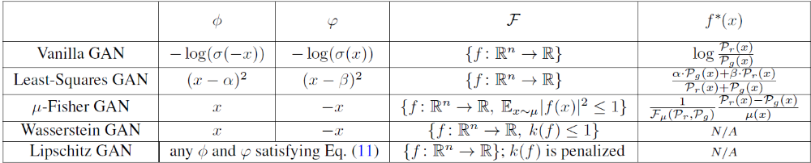


Generalized Formulation of GANs
$$\min_{G}{\max_{D}{L(G, D)}}$$
$$\min_{g}{\max_{f}}𝔼_{z\sim P_{z}}∅\left(f\left(g(z)\right)\right)+𝔼_{x\sim P_{r}}φ\left(f\left(x\right)\right)$$
$f$ is another notation for $D$ and $f^{∗}$ is the optimal $f$.

Slide 9
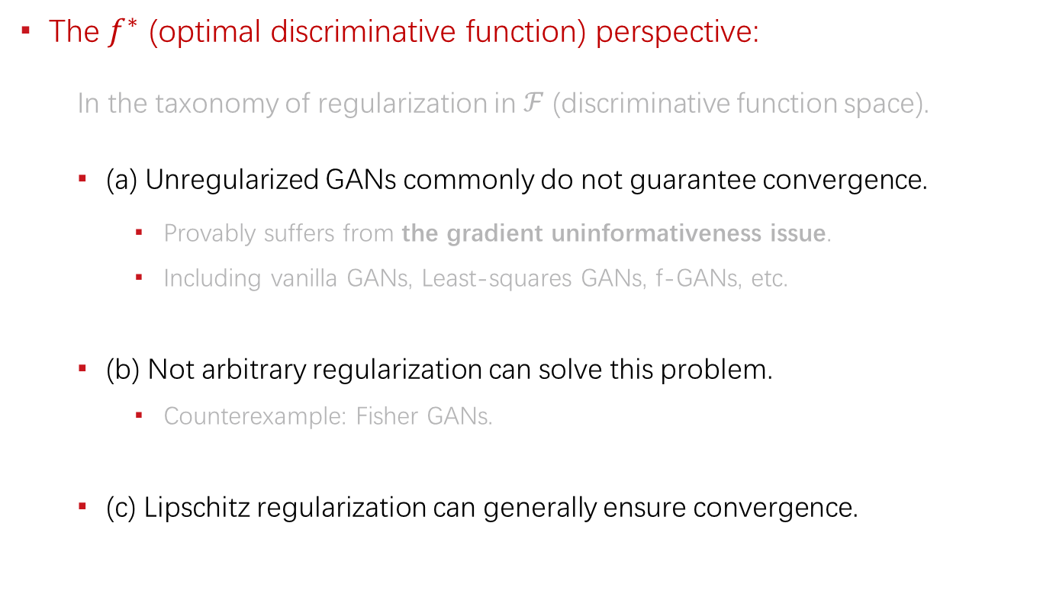
The Essence of Convergence
The $f^{∗}$ (optimal discriminative function) perspective:
  In the taxonomy of regularization in $ℱ$ (discriminative function space).
  (a) Unregularized GANs commonly do not guarantee convergence.
    Provably suffers from the gradient uninformativeness issue.
    Including vanilla GANs, Least-squares GANs, f-GANs, etc.
  (b) Not arbitrary regularization can solve this problem.
    Counterexample: Fisher GANs.
  (c) Lipschitz regularization can generally ensure convergence.

Slide 10
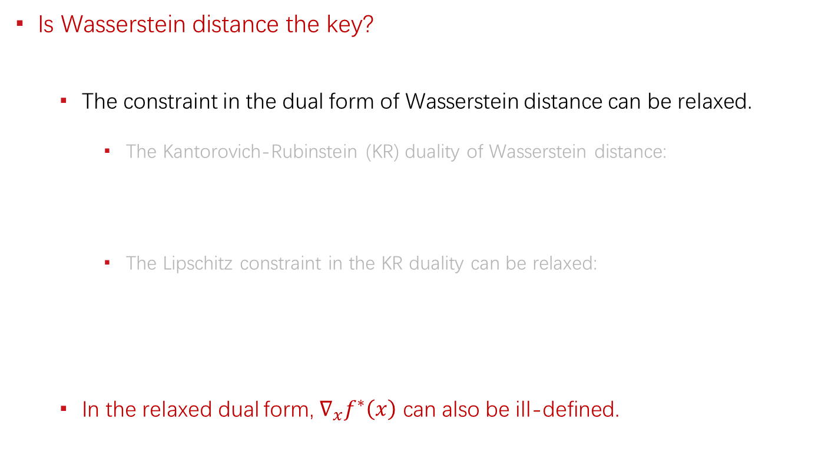


The Essence of Convergence
Is Wasserstein distance the key?
  The constraint in the dual form of Wasserstein distance can be relaxed.
    The Kantorovich-Rubinstein (KR) duality of Wasserstein distance:
    The Lipschitz constraint in the KR duality can be relaxed:
  In the relaxed dual form, $∇_{x}f^{∗}\left(x\right)$ can also be ill-defined.
  $$W_{1}\left(P_{r}, P_{g}\right)=\sup_{f} 𝔼_{x\sim P_{r}}\left[f\left(x\right)\right]−𝔼_{x\sim P_{g}}\left[f\left(x\right)\right],$$
  $$s.t. f\left(x\right)−f\left(y\right)≤d\left(x,y\right), ∀x, ∀y$$
  $$W_{1}\left(P_{r}, P_{g}\right)=\sup_{f} 𝔼_{x\sim P_{r}}\left[f\left(x\right)\right]−𝔼_{x\sim P_{g}}\left[f\left(x\right)\right],$$
  $$s.t. f\left(x\right)−f\left(y\right)≤d\left(x,y\right), ∀x∈supp(P_{r},) ∀y∈supp(P_{g})$$

Slide 11
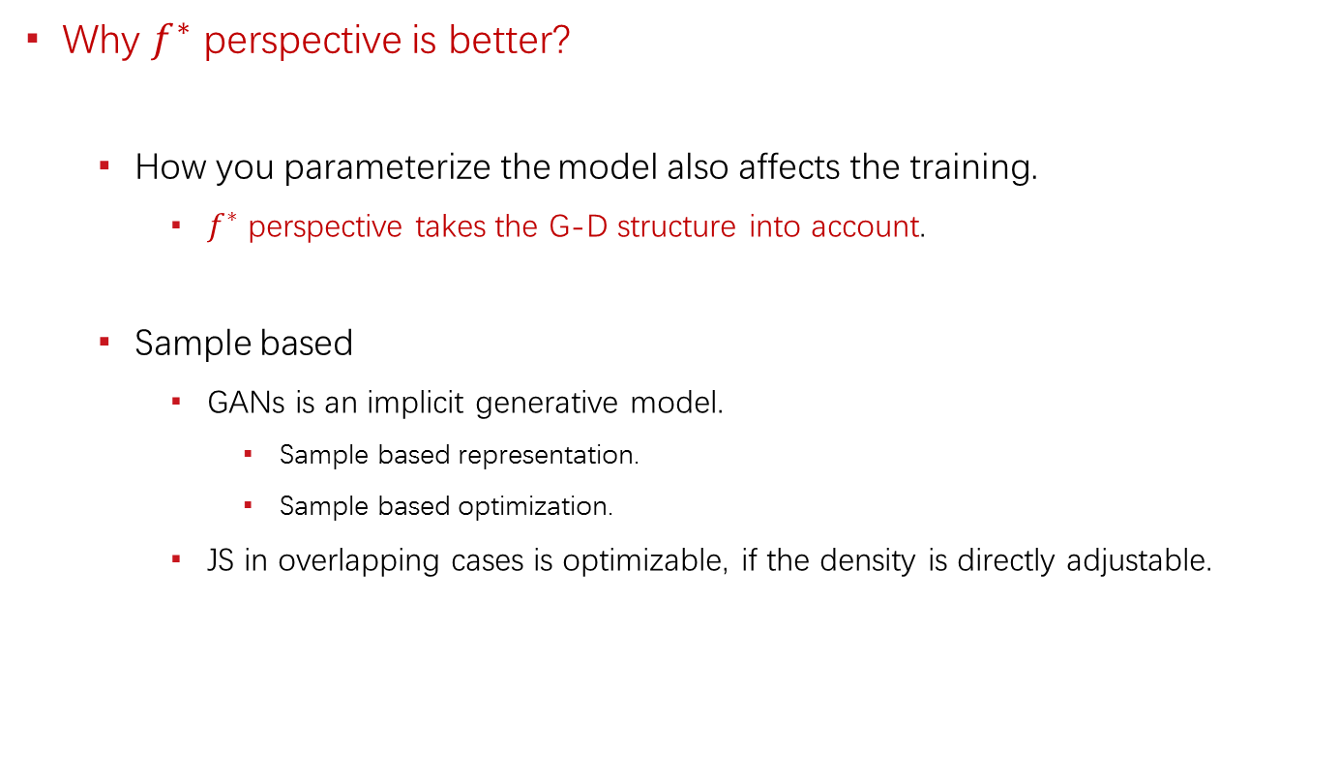
The Essence of Convergence
Why $f^{∗}$ perspective is better?
  How you parameterize the model also affects the training.
    $f^{∗}$ perspective takes the G-D structure into account.
  Sample based
    GANs is an implicit generative model.
      Sample based representation.
      Sample based optimization.
    JS in overlapping cases is optimizable, if the density is directly adjustable.

Slide 12
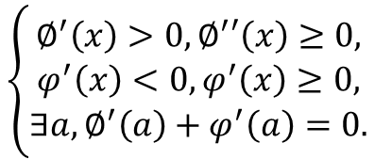
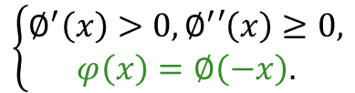

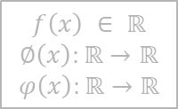
Lipschitz GANs
General formulation:
As long as, it satisfies:
Any increasing function with no decreasing derivative derives a LGANs.
The Lipschitz constant of $f$.
$$𝔼_{z\sim P_{z}}∅\left(f\left(g(z)\right)\right)+𝔼_{x\sim P_{r}}φ\left(f\left(x\right)\right)+λ∙{k(f)}^{2}$$
$$f\left(x\right) ∈ ℝ$$
$$∅\left(x\right):ℝ→ℝ$$
$$φ\left(x\right):ℝ→ℝ$$
The generalized formulation of GANs.
$$\left\{\begin{aligned}∅^{′}\left(x\right)>0,∅^{′}′\left(x\right)≥0, \\ φ^{′}\left(x\right)<0,φ^{′}\left(x\right)≥0, \\ ∃a,∅^{′}\left(a\right)+φ^{′}\left(a\right)=0.\end{aligned}\right.$$
or simplified as:
(more restrictive)
$$\left\{\begin{aligned}∅^{′}\left(x\right)>0,∅^{′}′\left(x\right)≥0, \\ φ\left(x\right)=∅\left(−x\right).\end{aligned}\right.$$

Slide 13
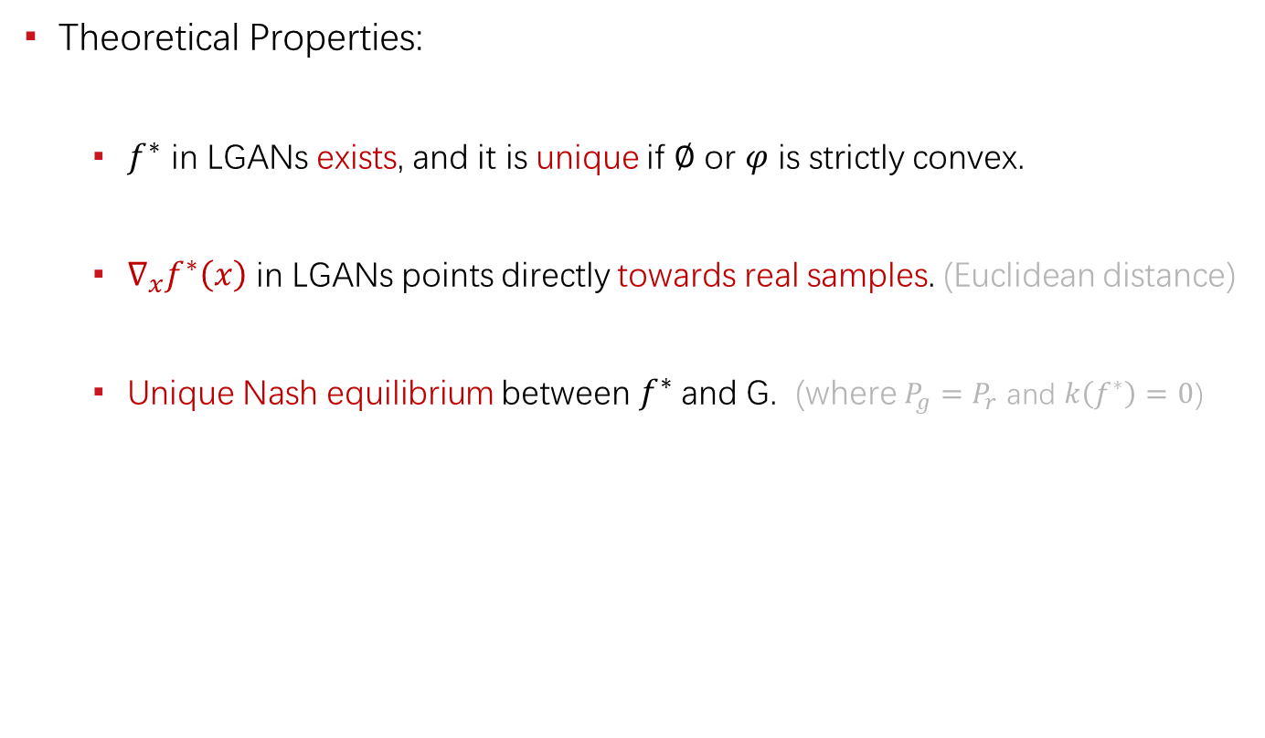
Lipschitz GANs
Theoretical Properties:
  $f^{∗}$ in LGANs exists, and it is unique if $∅$ or $φ$ is strictly convex.
  $∇_{x}f^{∗}\left(x\right)$ in LGANs points directly towards real samples. (Euclidean distance)
  Unique Nash equilibrium between $f^{∗}$ and G. (where $P_{g}=P_{r}$ and $k\left(f^{∗}\right)=0$)

Slide 14
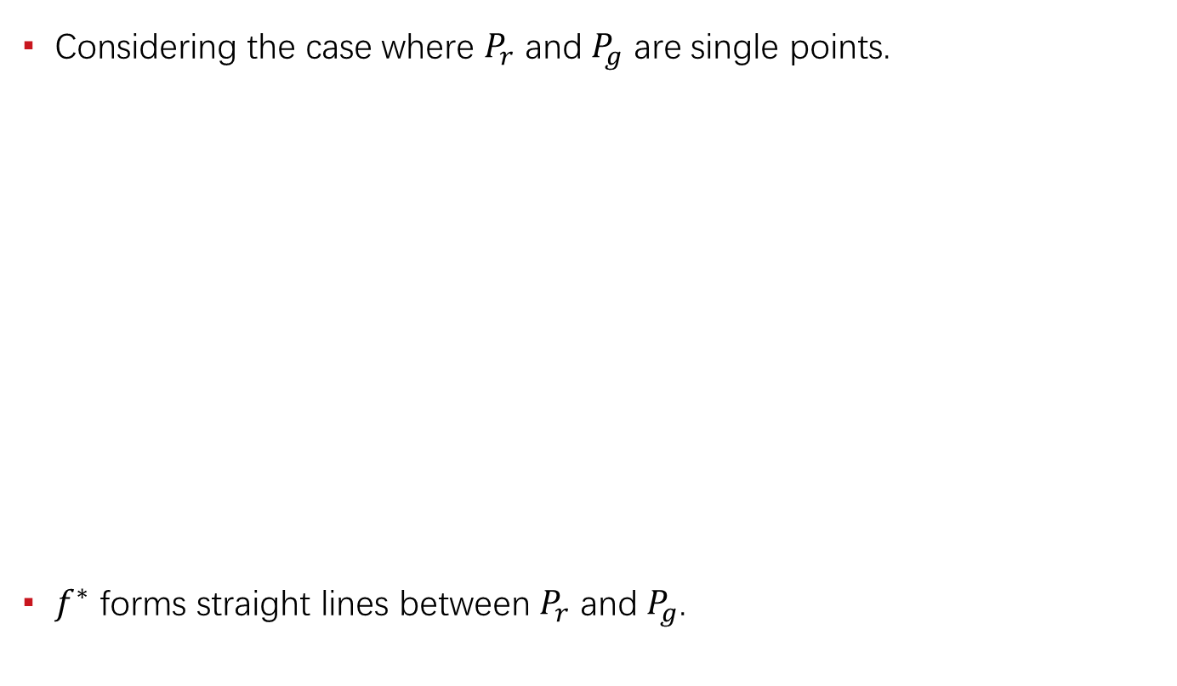




Illustration
Considering the case where $P_{r}$ and $P_{g}$ are single points.
$f^{∗}$ forms straight lines between $P_{r}$ and $P_{g}$.
$$f^{∗}(x)$$
The line in between is well defined, while others are not.
$$P_{r}$$
$$P_{g}$$
$$x$$

Slide 15
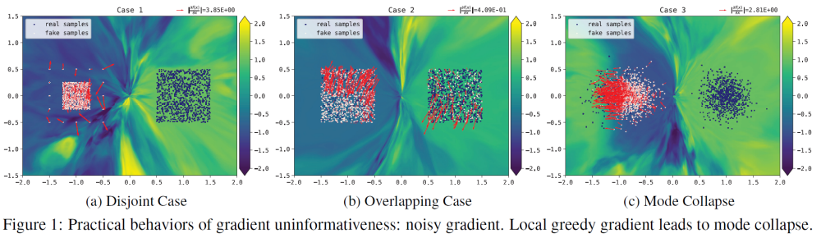
Experiments
Practical behaviors of gradient uninformativeness: (noise)

Slide 16
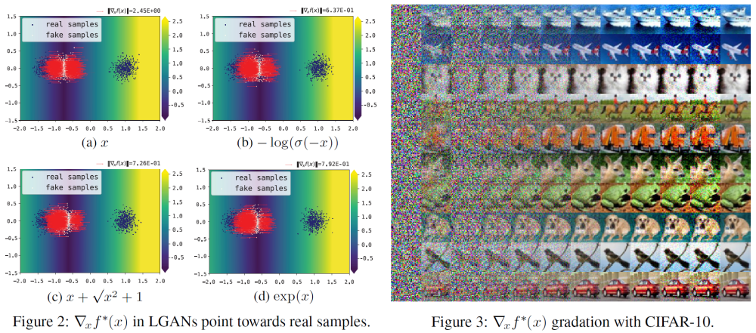
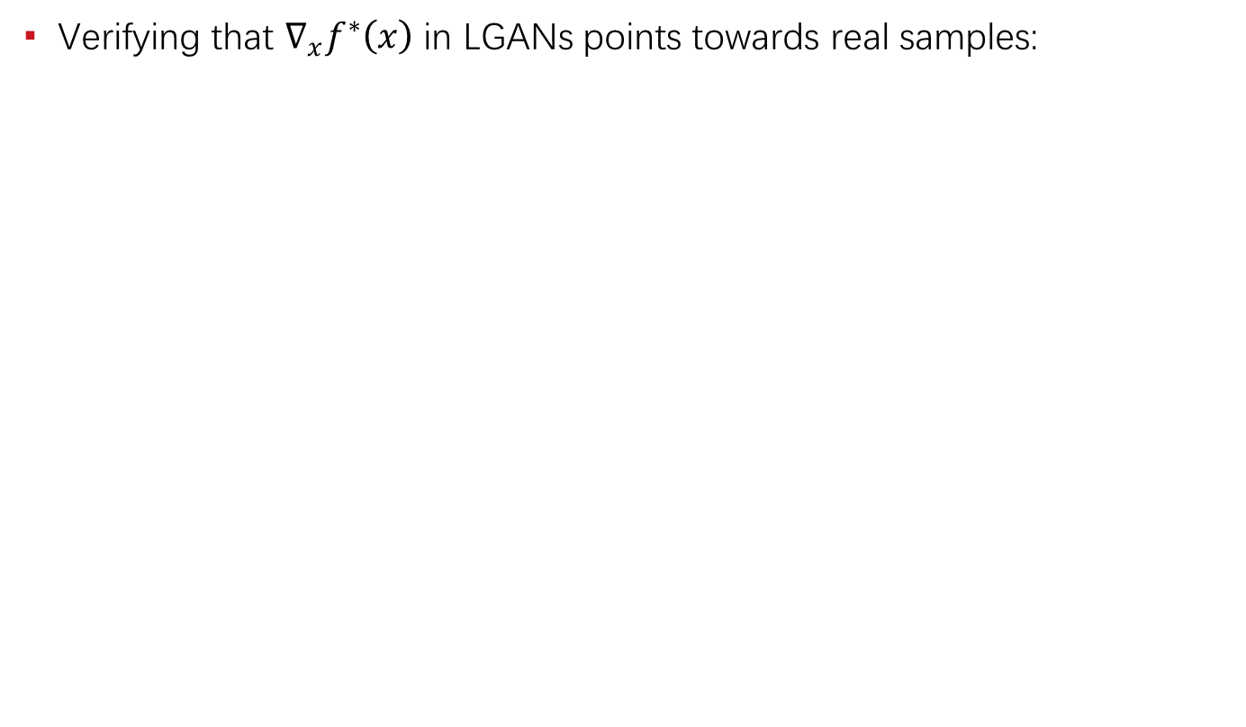
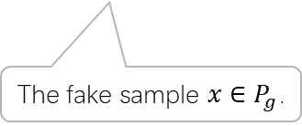
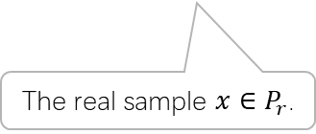

Experiments
Verifying that $∇_{x}f^{∗}\left(x\right)$ in LGANs points towards real samples:
The gradient $∇_{x}f^{∗}\left(x\right)$ and $x+k∙∇_{x}f^{∗}\left(x\right)$.
The fake sample $x∈P_{g}$.
The real sample $x∈P_{r}$.

Slide 17
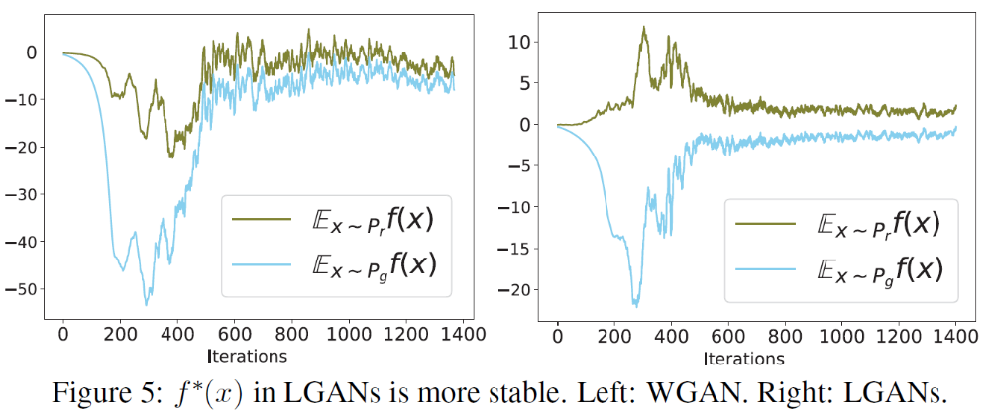

Experiments
The influence of uniqueness of $f^{∗}$: (stabilized)

Slide 18
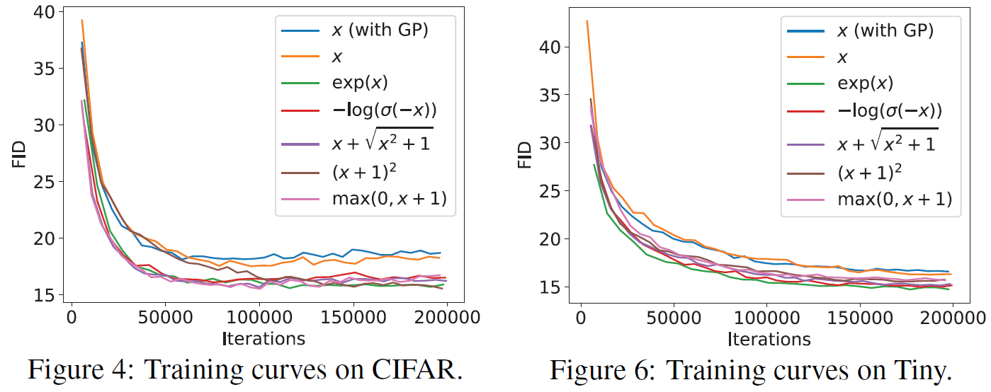
Experiments
Benchmark the LGANs family: (consistently outperform WGANs)

Slide 19
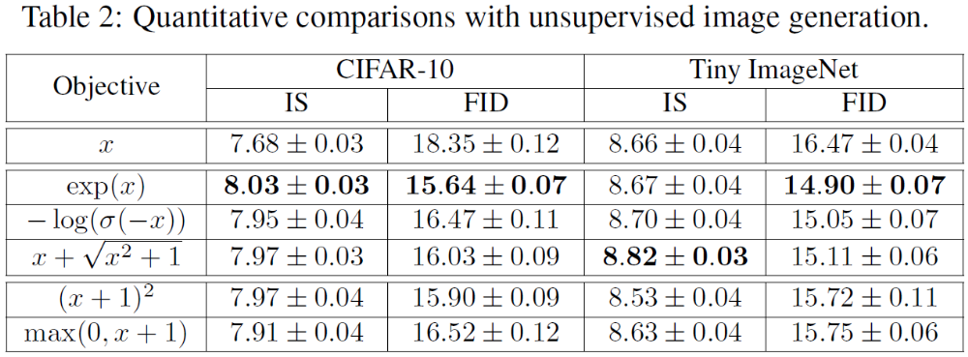
Experiments
Benchmark the LGANs family: (consistently outperform WGANs)

Slide 20
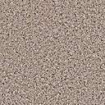
Mode Collapse
Objective level cause: (major)
  Unrestricted GANs (including vanilla GANs)
    Existence of gathering / clustering effect. (local greedy)
    Missing of force to separate clustered samples.
    Existence of local optimum.
  WGANs / LGANs
    No objective level local optimum.
    Existence of force to separate clustered samples. (if not clustered to a single point)
Neural network level cause: (minor)
  Network degeneration. (related to training failure)
  Limited capacity / expressiveness issue.
A local optimum state of some traditional GANs.

Slide 21
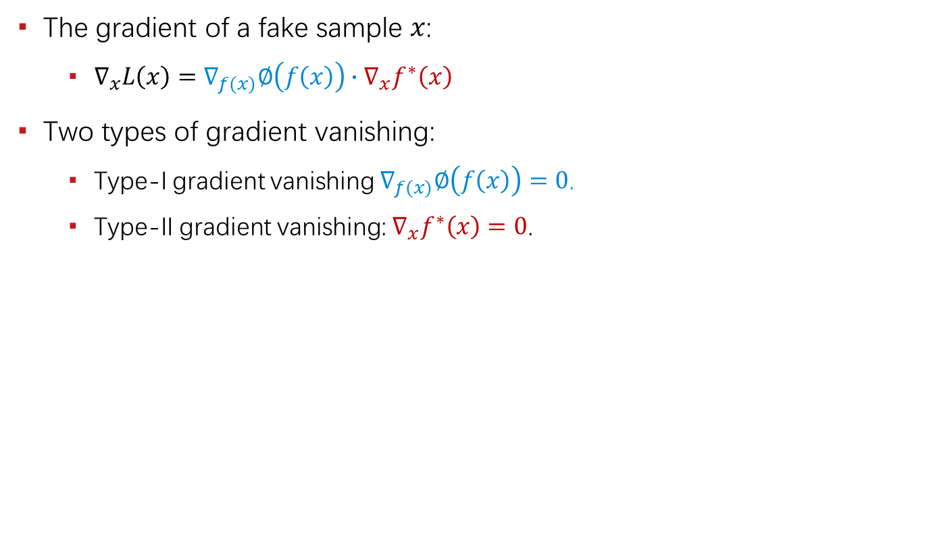
Gradient Vanishing
The gradient of a fake sample $x$:
  $∇_{x}L\left(x\right)=∇_{f(x)}∅\left(f\left(x\right)\right)∙∇_{x}f^{∗}\left(x\right)$
Two types of gradient vanishing:
  Type-I gradient vanishing $∇_{f(x)}∅\left(f\left(x\right)\right)=0$.
  Type-II gradient vanishing: $∇_{x}f^{∗}\left(x\right)=0$.
 | Type-I Gradient Vanishing | Type-II Gradient Vanishing
Vanilla GANs | Yes | Yes
Least-squares GANs | No | Yes
WGANs / LGANs | No | No

Slide 22
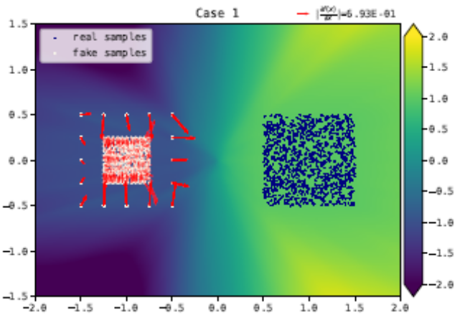
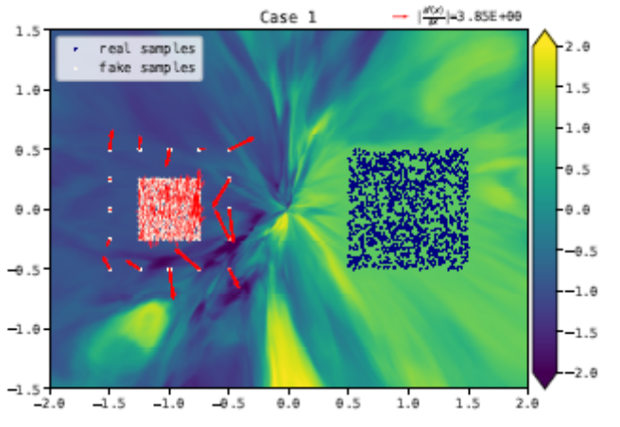
Understanding Unregularized GANs
The adversarial activation maximization process
  In contrast to the divergence perspective
How unregularized GANs work in practice
  Flat/simple network surface
    Network structure, optimizer, etc.
    Parameter tuning.
    Delicate balance between G and D.

Slide 23
Unreachable Optimum
Evidences & Possible Causes

Slide 24
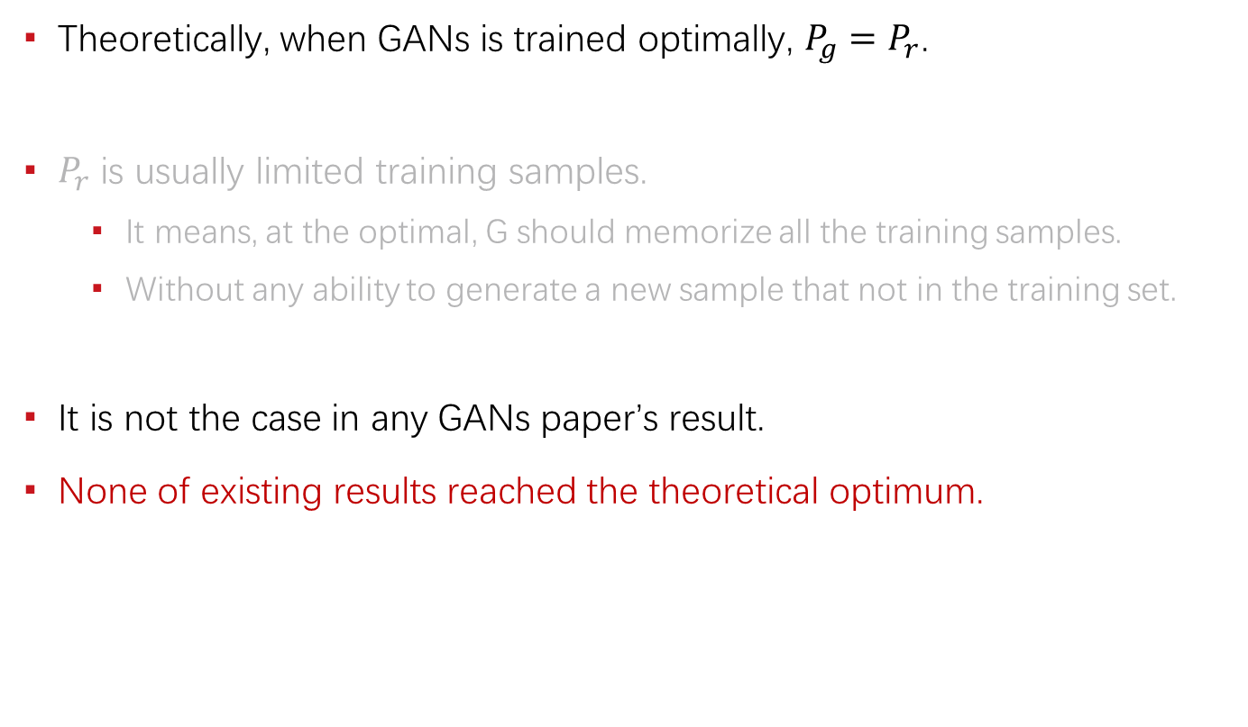
The Evidences
Theoretically, when GANs is trained optimally, $P_{g}=P_{r}$.
$P_{r}$ is usually limited training samples.
  It means, at the optimal, G should memorize all the training samples.
  Without any ability to generate a new sample that not in the training set.
It is not the case in any GANs paper’s result.
None of existing results reached the theoretical optimum.

Slide 25
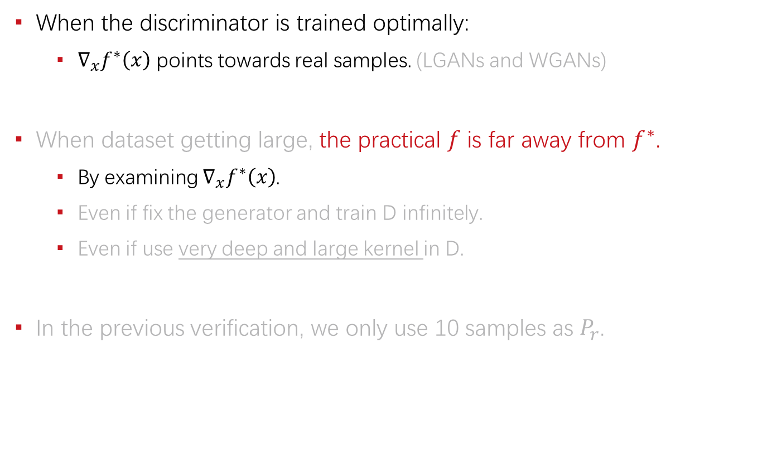
The Evidences
When the discriminator is trained optimally:
  $∇_{x}f^{∗}\left(x\right)$ points towards real samples. (LGANs and WGANs)
When dataset getting large, the practical $f$ is far away from $f^{∗}$.
  By examining $∇_{x}f^{∗}\left(x\right)$.
  Even if fix the generator and train D infinitely.
  Even if use very deep and large kernel in D.
In the previous verification, we only use 10 samples as $P_{r}$.

Slide 26
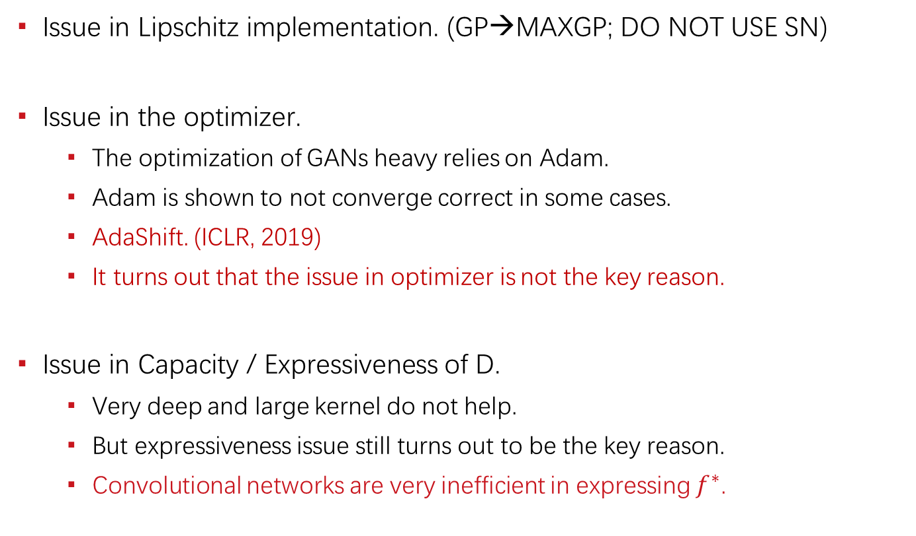
Possible Causes
Issue in Lipschitz implementation. (GP→MAXGP; DO NOT USE SN)
Issue in the optimizer.
  The optimization of GANs heavy relies on Adam.
  Adam is shown to not converge correct in some cases.
  AdaShift. (ICLR, 2019)
  It turns out that the issue in optimizer is not the key reason.
Issue in Capacity / Expressiveness of D.
  Very deep and large kernel do not help.
  But expressiveness issue still turns out to be the key reason.
  Convolutional networks are very inefficient in expressing $f^{∗}$.

Slide 27
Reference
[1] Zhou, Zhiming, Jiadong Liang, Yuxuan Song, Lantao Yu, Hongwei Wang, Weinan Zhang, Yong Yu, and Zhihua Zhang. "Lipschitz Generative Adversarial Nets." In International Conference on Machine Learning (ICML), 2019.
[2] Zhou, Zhiming*, Qingru Zhang*, Guansong Lu, Hongwei Wang, Weinan Zhang, and Yong Yu. "AdaShift: Decorrelation and Convergence of Adaptive Learning Rate Methods." In International Conference on Learning Representations (ICLR), 2019.
[3] Zhou, Zhiming, Han Cai, Shu Rong, Yuxuan Song, Kan Ren, Weinan Zhang, Jun Wang, and Yong Yu. "Activation Maximization Generative Adversarial Nets." In International Conference on Learning Representations (ICLR), 2018.
https://scholar.google.com/citations?user=b8YJ1EMAAAAJ&hl=en

Slide 28
谢 谢！

